Slide 2
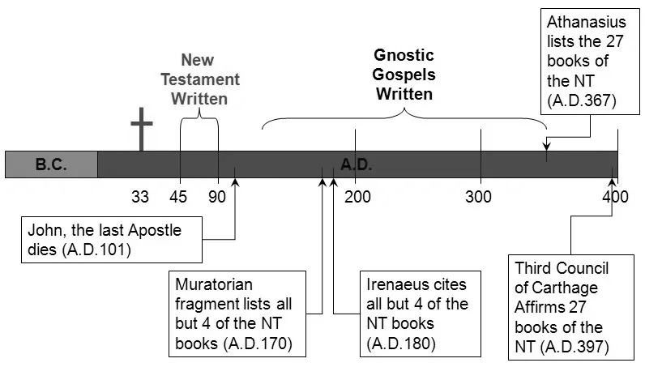
2) The origins of the canon
Old Testament (1500-400BC)
New Testament (1-100AD)
Patristic period (100-400AD)

Slide 3
The Old Testament
“ ‘The days are coming,’ declares the Lord,
‘when I will make a new covenant
with the people of Israel’” - Jer 31:31
“In the same way, after the supper he took the cup, saying, ‘This cup is the new covenant in my blood, which is poured out for you’” – Luke 22:20
“He has made us competent as ministers of a new covenant—not of the letter but of the Spirit . . .
But their minds were made dull, for to this day the same veil remains when the old covenant is read.”
- 2 Cor 3:6-14
“Then the Lord said to Moses, ‘Write this on a scroll as something to be remembered”
- Exodus 17:14
“When Moses went and told the people all the Lord’s words and laws, they responded with one voice, ‘Everything the Lord has said we will do.’ Moses then wrote down everything the Lord had said . . . Then he took the Book of the Covenant and read it to the people.”
- Exodus 24:4-7
“The Ten Commandments given at Sinai, clearly the core of God’s covenant with Israel, had
A preamble (Ex. 20:2a, “I am the LORD your God”)
A historical prologue (Ex. 20:2b, “who brought you out of the land of Egypt . . .”)
A list of stipulations (Ex. 20:3–17),
A list of blessings and curses (Ex. 20:5, 6, 7, 11, 12), and, most notably,
Two copies of the covenant in written form deposited in the holy place of worship (Ex. 31:18; Deut. 10:2)”
- Michael J. Kruger
The church has never been without a canon
The OT itself reveals aspects its origins
Covenant as the structural framework of the canon
“But as for you, continue in what you have learned and have become convinced of, because you know those from whom you learned it, and how from infancy you have known the Holy Scriptures, which are able to make you wise for salvation through faith in Christ Jesus. All Scripture is God-breathed and is useful for teaching, rebuking, correcting and training in righteousness, so that the servant of God may be thoroughly equipped for every good work.”
- 2 Timothy 3:14-17
Notes:
Covenant text later kept in the temple (Josh 24:26; 2 Kgs 22:8)
Jeremiah told to write down his prophetic oracles (Jer 36:2), Proverbs a collection of wisdom sayings of Solomon (Prov 1:1) and others (22:17; 30:1; 31:1). Many of the books, however, remain anonymous.
Generally recognized that biblical covenants structured similarly to ANE suzerain treaties . . . relationships expressed through covenant . . . Agreement between two parties
Covenant and covenant renewal in OT follows God’s great redemptive acts: revelation follows and interprets redemption
OT expectation of a new covenant – OT “A story without an ending”
God’s redemptive acts in Christ inaugurate a new covenant
Jesus transforms the covenant meal of Passover etc.
“New Testament” = “Novum Testamentum” (Latin) = “καινὴ διαθήκη (new covenant)” (Greek)

Slide 4
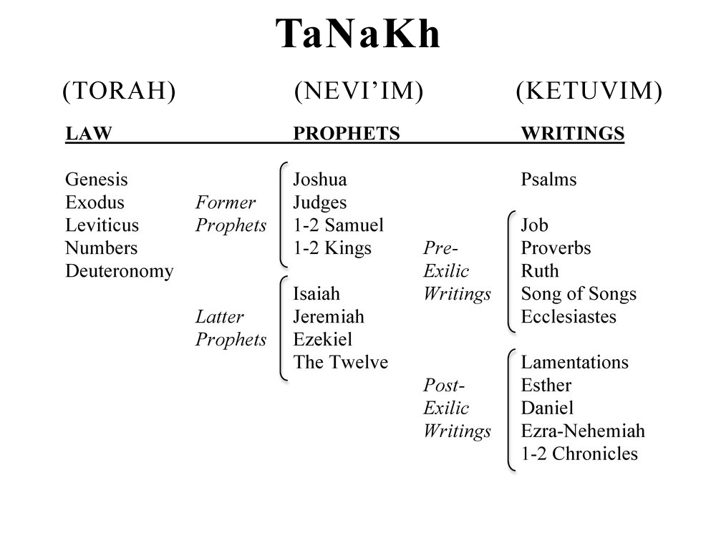
The Old Testament
“Naturally, then, or rather necessarily - seeing that it is not open to anyone to write of their own accord, nor is there any disagreement present in what is written, but the prophets alone learned, by inspiration from God, what had happened in the distant and most ancient past and recorded plainly in their own time just as they occurred - among us there are not thousands of books in disagreement and conflict with each other, but only twenty-two books, containing the record of all time, which are rightly trusted. Five of these are the books of Moses, which contain both the laws and the tradition from the birth of humanity up to his death; this is a period of a little less than 3,000 years. From the death of Moses until Artaxerxes, king of the Persians after Xerxes, the prophets after Moses wrote the history of what took place in their own times in thirteen books; the remaining four books contain hymns to God and instruction for people on life . . .
. . . From Artaxerxes up to our own time every event has been recorded but this is not judged worthy of the same trust, since the exact line of succession of the prophets did not continue. It is clear in practice how we approach our own writings. Although such a long time has now passed, no-one has dared to add, to take away, or to alter anything; and it is innate in every Judean right from birth, to regard them as decrees of God, to remain faithful to them and, if necessary, to die on their behalf. Thus, to date many have been seen, om many occasions, as prisoners of war suffering torture and all kinds of death in theaters for not letting slip a single word in contraventions of the laws and records associated with them.”
- Josephus Against Apion 8.37-43
“It is very striking that, over a period ranging from the second century BCE to the first century CE, so many writers of so many divergent groups (Palestinian, Hellenistic, Pharisaic, Essene, Christian) show such agreement about the canon of the Hebrew Bible . . . None of these witnesses are concerned with asserting the authority of the books they mention, rather they all assume the Scripture’s authority, and go on to debate about their interpretation. It is clear that these groups do not speak simply for themselves but represent Judaism as a whole . . . Any inference that the canon was decided by councils must be abandoned. The role of later councils was not to decide the canon, but to confirm decisions about the canon already reached in other ways.”
- Roger Beckwith The Formation of the Hebrew Bible
Division of the OT
Josephus’ evidence
Remarkable unity among 1C Jews regarding the canon
Jesus’ view of the OT: “What the OT says, God says”
“He said to them, ‘This is what I told you while I was still with you: Everything must be fulfilled that is written about me in the Law of Moses, the Prophets and the Psalms.’”
- Luke 24:44
Notes:
Josephus:
Has a canonical list… exactly 22 books… is clearly aware of other Jewish books as well
Aware of canonical titles / organization: the law, the prophets and other writings / hymns
Aware of a “canonical epoch”: succession of the prophets did not continue…
Aware of a “canonical consensus”: Josephus speaking here on behalf of clearly the majority of Jews
Aware of canonical text that has not been changed for “long ages”
“The whole story of Israel builds to its narrative climax in Jesus, the Messiah who had to suffer before entering into his glory. That is what Jesus tries to teach them on the Emmaus road.”

Slide 5
The New Testament
“Jesus went up on a mountainside and called to him those he wanted, and they came to him. He appointed twelve that they might be with him and that he might send them out (ἀποστέλλω) to preach and to have authority to drive out demons.”
- Mark 3:13-15
Apostle the Greek equivalent of the Hebrew שָלִיחַ shaliach, an authoritative legal agent
“a person’s agent is regarded as the person himself” (Ned. 72B; Kidd, 41b)
“The Evangelists were in more or less direct contact with eyewitnesses, not removed from them by a long process of anonymous transmission of the traditions . . . The traditions were originated and formulated by named eyewitnesses, in whose name they were transmitted and who remained the living and active guarantors of the traditions.”
- Richard Bauckham Jesus and the eyewitnesses
Context: a story without an ending, Israel still in ‘exile’, prophetic hope
NT writers connect Jesus’ story to the story of Israel
Twelve apostles Jesus’ authoritative representatives
NT tells the story of redemption accomplished (Gospels), proclaimed (Acts), applied (Epistles), and consummated (Revelation)
Written within living memory of eyewitnesses and completed by the end of the 1C
“This is the genealogy of Jesus the Messiah the son of David, the son of Abraham” - Matt 1:1
“In the beginning was the Word, and the Word was with God, and the Word was God.” – John 1:1
“But when the set time had fully come, God sent his Son, born of a woman, born under the law, to redeem those under the law, that we might receive adoption to sonship” – Gal 4:4-5
Notes:
Must understand this Jewish background and story to understand the New Testament. Until the mid-20C much scholarship saw the early Christian message as a new “universal” message that quickly left aside its Jewish roots. Jesus was interpreted against the background of Graeco-Roman mystery religions… Christians, who lived and were highly familiar with the pagan and Hellenistic communities of the Roman world, developed a belief that Jesus was Kyrios, Lord, analogous to other pagan beliefs in cultic deities and deified men (Bousset).
Largely through the work of the “Cambridge triumvirate” of Westcott, Lightfoot, and Hort in the late 19C, the thesis of F.C. Baur, who had argued that many New Testament books were written late into the second century, was challenged. Westcott especially demonstrated the early dates of the Ignatian and Clementine epistles which quote from or allude to much of the NT and point to much earlier dates for the NT itself.
“If Baur was right, large parts of the New Testament were written subsequently to A.D. 130. The letters we are studying give no support whatever to this view, and at certain points emphatically contradict it. It is true that neither writer gives the impression of being aware of the existence of anything like a Canon of New Testament Scripture, a collection of sacred books venerated by all the churches, such as we find already in Irenaeus (c. A.D. 180). Moreover, there are few actual quotations from New Testament books. The tendency, especially in Ignatius, is far more to refer to Christian writings of an earlier date, to summarize their teaching, or to represent it in language less exact than that of quotation. Similarly, Clement refers to the Gospels, to Epistles of Paul, to the teaching of the Epistle of James, and again and again to the teaching of the Epistle to the Hebrews.” –
Neil and Wright The Interpretation of the New Testament

Slide 6
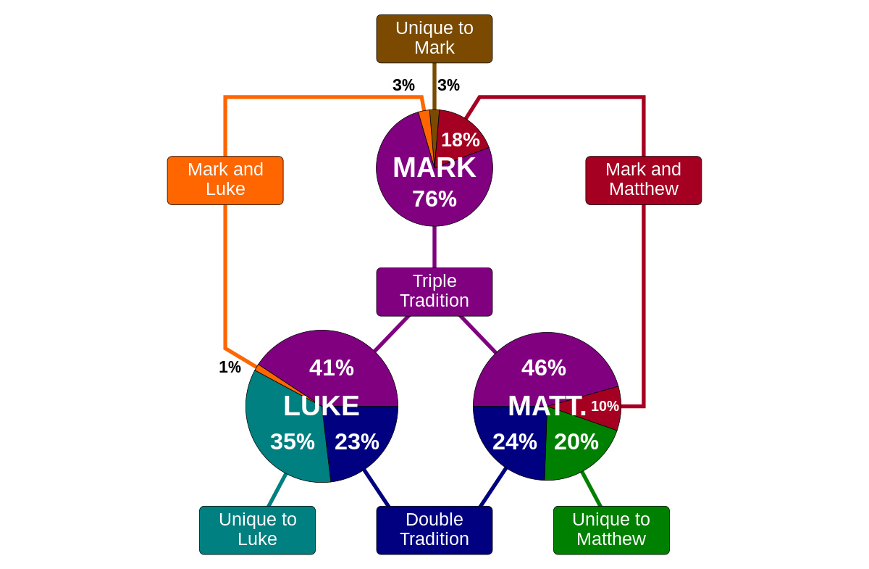
Gospels
“The beginning of the good news (εὐαγγέλιον) about Jesus the Messiah, the Son of God”
- Mark 1:1
“This is the disciple who testifies to these things and who wrote them down. We know that his testimony is true.”
- John 21:24
Generally accepted that Mark the first gospel written (+- 60-70AD).
Matthew and Luke typically dated 70-90AD and John 80-100AD.
Awareness of apostolic authority
The literary relationship between the gospels
Gospels soon brought together as a collection with titles “According to Mark” etc.
“It is not possible that the Gospels be either more or fewer than they are. For since there are four zones of the world in which we live, and four principal winds, the pillar and the ground of the Church is the Gospel . . . it is fitting that we should have four pillars”
- Irenaeus Against Heresies (+- 180AD)
“The Elder used to say: Mark, in his capacity as Peter’s interpreter, wrote down accurately as many things as he recalled from memory — though not in an ordered form — of the things either said or done by the Lord. ”
- Papias (+- 110AD)
Notes:
Why gospels not dated earlier? Hard to believe that Paul would not have quoted from these more frequently in his letters if he had access to them
Relationship of Gospels to the Jewish War (66-70AD) and the destruction of the temple are often a key datum in dating the writings
Referring to the use of “euanggelion” in the introduction of Mark: “The term was not originally used among early Christians to refer to written texts, but was a reference to the authoritative message of the apostolic preaching. In addition, the phrase “son of God” occurs not only in 1:1 but again at the end of Mark’s Gospel in 15:39, forming a literary inclusio. This structure suggests that the opening line is “more than just an introduction to the Baptist’s ministry,” but is an implicit claim of authority designed “to characterize the work as a whole as the ‘Gospel of Jesus Christ.’” - Kruger
Titles “According to” reflect that the early church believed there was one gospel told from a variety of angles

Slide 7
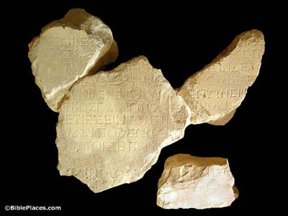
Paul’s Letters
Chronology from Wright Paul: A biography
5AD? Born
33? Encounters Jesus on Damascus road
33-46 Paul in Damascus, Arabia, Tarsus
46/47 “Famine visit” to Jerusalem (Gal 2:1-10)
47-48 First missionary journey South Galatia
48/49 Jerusalem conference (Acts 15)
51 Paul in Corinth
52/53 Third missionary journey
54/56 Imprisonment Ephesus
57-59 Travel to Jerusalem and imprisonment
60-62 House arrest in Rome
62-64 Further travels to Spain?
64? Death of Paul
“While Gallio was proconsul of Achaia, the Jews of Corinth made a united attack on Paul and brought him to the place of judgment.”
Acts 18:12
“Gallio inscription” found in 1905 in Delphi
“And we also thank God constantly for this, that when you received the word of God, which you heard from us, you accepted it not as the word of men but as what it really is, the word of God”
– 1 Thess 2:13
“If anyone thinks that he is a prophet, or spiritual, he should acknowledge that the things I am writing [γράϕω] to you are a command of the Lord. If anyone does not recognize this, he is not recognized.”
– 1 Cor 14:37-38
For what I received I passed on to you as of first importance: that Christ died for our sins according to the Scriptures, that he was buried, that he was raised on the third day according to the Scriptures”
1 Cor 15:3-4
Generally accepted as the earliest documents in the NT
Paul refers to earlier traditions he received
Possible to reconstruct a chronology of Paul’s life with a fair degree of accuracy
Paul’s apostolic self-consciousness
Letters collected and circulated from an early date
Notes:
Historians typically look first to Paul as our most important source of historical information about Jesus and the early Christians
Words from the Gallio inscription found in 1905 in Delphi, Greece:
“Tiberius Claudius Caesar Augustus Germanicus, 12th year of tribunician power, acclaimed emperor for the 26th time, father of the country, sends greetings to [… ]. For long have I been well-disposed to the city of Delphi and solicitous for its prosperity, and I have always observed the cult of the Pythian Apollo. Now since it is said to be destitute of citizens, as my friend and proconsul L. Iunius Gallio recently reported to me”

Slide 8
Other NT writings
“Blessed is the one who reads aloud the words of this prophecy, and blessed are those who hear, and who keep what is written in it, for the time is near”
– Revelation 1:3
“If anyone adds . . . and if anyone takes away . . .”
- Revelation 22:18-19
“Now, Israel, hear the decrees and laws I am about to teach you . . . Do not add to what I command you and do not subtract from it, but keep the commands of the Lord your God that I give you.”
- Deut 4:2
“It used to be said that the New Testament writers ‘didn’t think they were writing Scripture.’ That is hard to sustain historically today. The fact that their writings were, in various senses, ‘occasional’ . . . is not to the point. At precisely those points of urgent need (when, for instance, writing Galatians or 2 Corinthians) Paul is most conscious that he is writing as one authorized, by the apostolic call he had received from Jesus Christ, and in the power of the Spirit, to bring life and order to the church by his words”
- Wright Scripture and the authority of God
Acts the companion volume to Luke and dated similarly
General epistles: Hebrews, James, 1 Peter, 2 Peter, 1-3 John, Jude
Revelation
“That which was from the beginning, which we have heard, which we have seen with our eyes, which we looked upon and have touched with our hands, concerning the word of life—the life was made manifest, and we have seen it, and testify [μαρτυροῦμϵν] to it and proclaim [ἀπαγγέλλομϵν] to you the eternal life.”
– 1 John 1:1-2
Notes:
Other NT writings also claim apostolic authority
Hebrews associated with Paul from early on… epistles of John listed with the gospel in Muratorian fragment etc.
For 1 John:
“A number of aspects of this verse support the idea that the author is laying forth his apostolic credentials. (1) The vivid eyewitness language—hearing, seeing, even touching—confirms that the author was present to witness the ministry of Jesus and thus fits the criteria of an apostle (Luke 1:2; 24:48; Acts 1:9). Marshall affirms, “There cannot be any real doubt that the writer claims to have been an eyewitness of the earthly ministry of Jesus.”¹³³ As an eyewitness, the author is qualified to “testify” (μαρτυροῦμϵν) to what he has seen and heard. (2) In addition to testifying, the author also takes on the more authoritative task of “proclaiming” (ἀπαγγέλλομϵν) the word of life. Stott notes, “In order to testify, the apostles must have seen and heard Christ for themselves; in order to proclaim they must have received a commission from him.”¹³⁴ The act of proclamation confirms the apostolic office already established by the claims to be an eyewitness. (3) The author’s apostolic authority to speak is established also by the use of the collective “we”—indicating that John is speaking not simply as an individual, but as part of the larger apostolic witness. ” – Kruger
Revelation clearly claim to be authoritative testimony

Slide 9
Early references to canonical books
“And when this letter has been read among you, have it also read in the church of the Laodiceans.”
- Col 4:16
“I put you under oath before the Lord to have this letter read to all the brothers.”
- 2 Cor 10:9
“Devote yourself to the public reading of Scripture”
- 1 Tim 4:13
“Bear in mind that our Lord’s patience means salvation, just as our dear brother Paul also wrote you with the wisdom that God gave him. He writes the same way in all his letters, speaking in them of these matters. His letters contain some things that are hard to understand, which ignorant and unstable people distort, as they do the other Scriptures, to their own destruction.”
- 2 Peter 3:15-16
“I want you to recall the words spoken in the past by the holy prophets and the command given by our Lord and Savior through your apostles.”
- 2 Peter 3:2
“He has made us competent as ministers of a new covenant”
- 2 Cor 3:6
The reference to Paul’s letters as Scripture in 2 Peter 3:15-16
The reference to Luke 10:7 as Scripture in 1 Timothy 5:18
Allusions to a bi-covenantal canon
Public reading of canonical books
The elders who direct the affairs of the church well are worthy of double honor, especially those whose work is preaching and teaching. For Scripture says, ‘Do not muzzle an ox while it is treading out the grain,’ and ‘The worker deserves his wages’”
- 1 Timothy 5:18 (quoting Deut 25:4 and Luke 10:7)
Notes:
Reference is made here to a collection of letters… all his letters… author expects his reader to know what he is referring to

Slide 10
Apostolic fathers
“Paul, who was sanctified, who gained a good report, who was right blessed, in whose footsteps may I be found when I shall attain to God, who in every epistle makes mention of you in Christ Jesus.”
- Epistle to the Ephesians 12:2
“Throughout his writings, Ignatius offers repeated and overt references to the absolute and unparalleled authority of the apostles”
- Kruger Canon Revisited
“Take up the epistle of that blessed apostle, Paul . . . To be sure, he sent you a letter in the Spirit concerning himself and Cephas and Apollos”
- 1 Clement 47:1-3
“The Apostles received the Gospel for us from the Lord Jesus Christ, Jesus the Christ was sent from God. The Christ therefore is from God and the Apostles from the Christ.”
- 1 Clement 42:1-2
Clement writing from Rome (+- 95AD) highlights Paul’s letter to the Corinthians and emphasizes apostolic authority
The Didache, a Christian manual on church practice (+- 100AD), quotes from Matthew
Ignatius, on his way to martyrdom in Rome (+- 110AD), quotes from or alludes to numerous NT writings
“Nor should you pray like the hypocrites, but as the Lord commanded in his gospel, you should pray as follows, ‘Our Father in heaven. . . ’”
- Didache 8:2
“It seems hard to resist the notion that there is some relationship between the Didache and Matthew here”
- Christopher Tuckett
Notes:
“It is clear that Ignatius knows, and assumes his readers already know, about some collection of Paul’s letters. Although this collection would certainly have included 1 Corinthians, Ephesians, and 1 and 2 Timothy, the fact that Ignatius also appears to know Romans, Philippians, and Galatians suggests that his Pauline letter collection might have been quite extensive” - Kruger

Slide 11
Apostolic fathers
“As it is written, ‘Many are called, but few are chosen.’”
- Epistle of Barnabas 4:14 quoting Matthew 22:14
“The often inaccurate quotations in the Fathers, it is argued, show that they were drawing on ‘synoptic tradition’ but not actually on the Synoptic Gospels. Such a theory cannot be ruled out absolutely, but it is not the only or, probably, the best explanation for loose quotation. . . . The explanation is to be found not in oral transmission in the strict sense, but in the oral use of texts which were already available in written form”
- John Barton
“As it is written in these Scriptures, ‘Be angry and do not sin and do not let the sun go down on your anger.’”
- Epistle to the Philippians 12:1 (quoting Eph 4:26)
“. . . but being mindful of what the Lord said in His teaching: Judge not, that you be not judged; forgive, and it shall be forgiven unto you; be merciful, that you may obtain mercy; with what measure you measure, it shall be measured to you again; and once more, Blessed are the poor, and those that are persecuted for righteousness' sake, for theirs is the kingdom of God”
- Idem 2:3
Polycarp (69-155AD), bishop of Smyrna, frequently quotes from Paul’s letters and loosely quotes from the Synoptic Gospels
The Epistle of Barnabas (+-130AD)
Papias (+-125AD) was clearly aware of Matthew, Mark, John, and possibly Luke, and accepted these as authoritative accounts

Slide 12
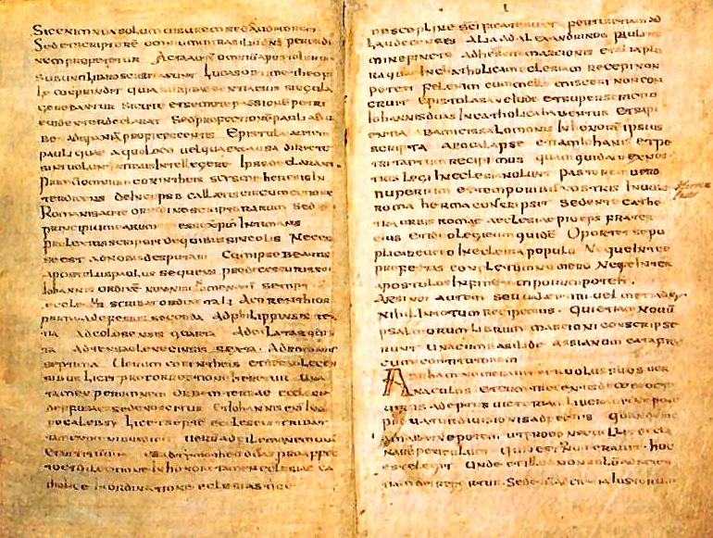
Other Second-Century Sources
“These opinions those who were presbyters before us, who accompanied the apostles, did not hand on to you. For while I was still a boy I knew you in lower Asia in Polycarp's house when you were a man of rank in the royal hall and endeavoring to stand well with him. I remember the events of those days more clearly than those which happened recently, for what we learn as children grows up with the soul and is united to it, so that I can speak even of the place in which the blessed Polycarp sat and disputed, how he came in and went out, the character of his life, the appearance of his body, the discourses which he made to people, how he reported his intercourse with John and with the others who had seen the Lord, how he remembered their words, and what were the things concerning the Lord which he had heard from them, and about their miracles, and about their teaching, and how Polycarp had received them from the eyewitnesses of the word of life, and reported all things in agreement with the Scriptures.”
- Irenaeus Letter to Florinus
“But Hermas wrote the Shepherd quite lately in our time in the city of Rome, when on the throne of the church of the city of Rome the bishop Pius, his brother, was seated.”
- Muratorian Fragment
Lists all NT books aside from Hebrews, James, 1-2 Peter
“And on the day called Sunday, all who live in cities or in the country gather together to one place, and the memoirs of the apostles or the writings of the prophets are read, as long as time permits; then, when the reader has ceased, the president verbally instructs, and exhorts to the imitation of these good things”
1 Apology 67:3
“And when it is said that He changed the name of one of the apostles to Peter; and when it is written in the memoirs of him that this so happened, as well as that He changed the names of other two brothers, the sons of Zebedee, to Boanerges, which means sons of thunder . . “
Dialogue with Trypho 106
Justin Martyr an early Christian apologist who sought to defend the faith against its Jewish and pagan detractors (+-150-160AD)
Irenaeus was a disciple of Polycarp who became bishop of Lyons and a significant Christian apologist especially in relation to Gnosticism (+-170-180AD)
Muratorian fragment an early list of canonical books (+-180-200AD)
“Irenaeus quotes New Testament books extensively, even more than the Old Testament, and clearly regards them as ‘Scripture.’ These include the four Gospels, Acts, the entire Pauline corpus (minus Philemon), Hebrews, James, 1 Peter, 1 and 2 John, and Revelation—over one thousand New Testament passages in total”
- Kruger Canon Revisited
“Astonishingly early, the great central core of the present New Testament was already being treated as the main authoritative source for Christians.”
- John Barton
Notes:
“The Muratorian fragment was discovered in the Ambrosian Library in Milan by Father Ludovico Antonio Muratori (1672–1750), the most famous Italian historian of his generation. Realizing its significance and antiquity, he published it in 1740” – Wikipedia
Pius I was bishop of Rome 140-154AD, thus generally accepted dating is within the second C

Slide 13
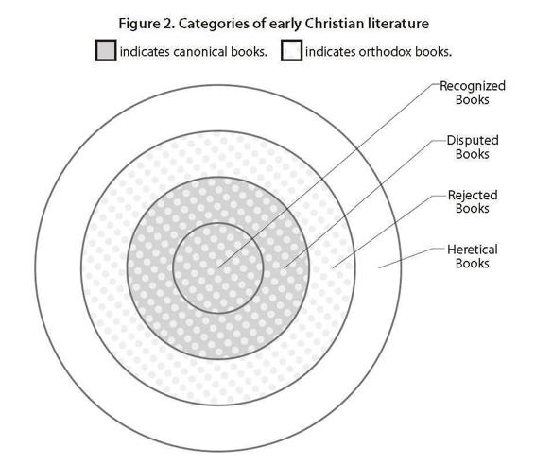
Final Formation
1) The “recognized books” (ὁμολογούμϵνα): the four Gospels, Acts, the epistles of Paul (including Hebrews), 1 John, 1 Peter, and Revelation.
2) The “disputed books” (ἀντιλϵγόμϵνα) which are still regarded as canonical because they “are nevertheless known to most.” These include James, Jude, 2 Peter, and 2 and 3 John.
3) The “rejected books” (νόθα) which are “orthodox”, but rejected as it pertains to their canonical status. These writings include the Acts of Paul, the Shepherd of Hermas, the Apocalypse of Peter, the Epistle of Barnabas, the Didache, and the Gospel of the Hebrews.
4) The “heretical books” are those that are roundly rejected as unorthodox “forgeries”. These include the Gospel of Peter, the Gospel of Thomas, the Gospel of Matthias, the Acts of Andrew, and the Acts of John.
Case Study: Why was the Gospel of Thomas rejected?
Written substantially later than the canonical
Influenced by later 2C Gnostic theology
Derivative from the canonical gospels
“Since a gnostic world view of this sort [in Thomas] was not employed to reinterpret Christianity in such a thoroughgoing way before sometime in the second century AD, there can be no question of the Gospel of Thomas . . . being a reliable reflection of the historical Jesus or of the earliest sources of 1st-century Christianity” – John Meier
“There are numerous examples of this consensus, most notably the Festal Letter of Athanasius in 367, where he affirms the precise twenty-seven books of our current New Testament. In agreement are also Eusebius, Codex Claromontanus, Rufinus, Jerome, Augustine, the African Canons, and the Synods of Hippo and Carthage. Although there was not absolute uniformity (which is true still today), after this period the church coalesced around these twenty-seven books with remarkable unity.”
- Kruger Canon Revisited
Origen lists our complete NT canon in his Homily on Joshua 7.1 (+-250AD)
Eusebius’ Church History (+-313AD) famously divides early Christian literature into four categories (3.25.1-7)
Athanasius’ festal letter (367AD) lists the 27 book NT canon and agreed at the synods of Hippo (393AD) and Carthage (397AD)
“before our Savior Jesus Christ this net was not wholly filled; for the net of the law and prophets had to be completed . . . And the texture of the net has been completed [πϵπλήρωται] in the Gospels, and in the words of Christ through the Apostles.”
Origen Commentary on Matthew 10:2
Notes:
Thomas lacks any narrative framework or emphasis on Jesus’ life, death, and resurrection as we find in the canonical gospels… infamous final line “Jesus said . . . ‘For every woman who makes herself male will enter the kingdom of heaven.’”

