Slide 2
3) The reliability of the canon
Textual transmission
Archaeological confirmation
Internal evidence of authenticity

Slide 3
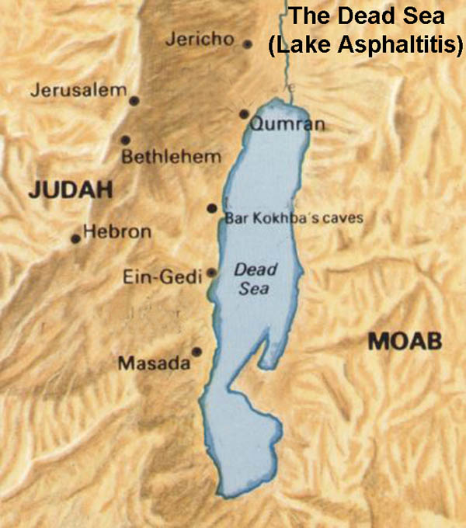
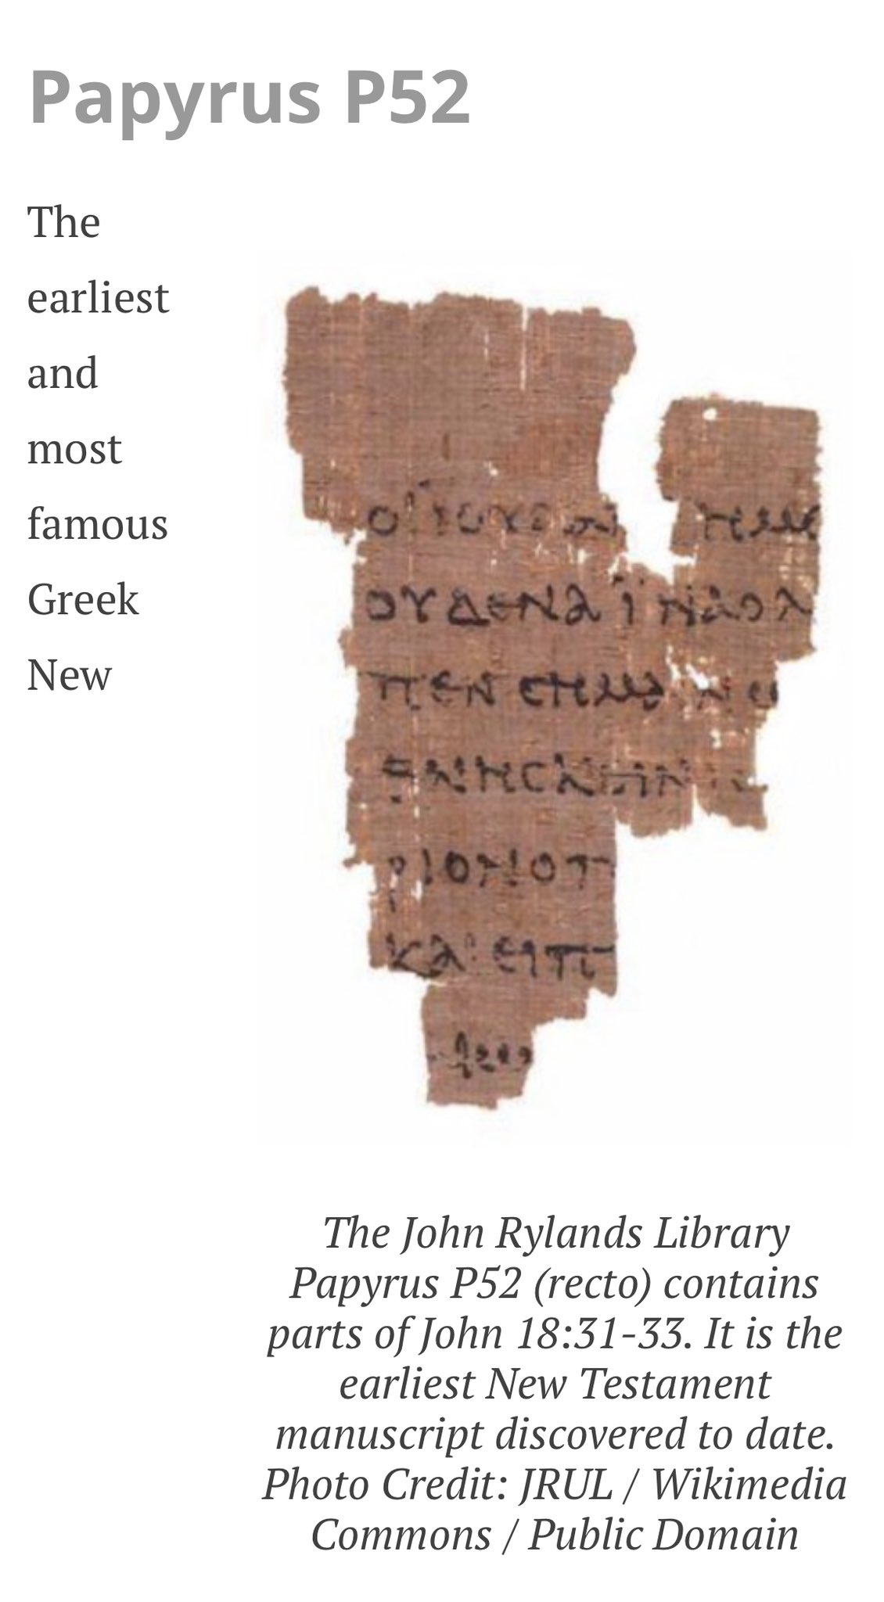
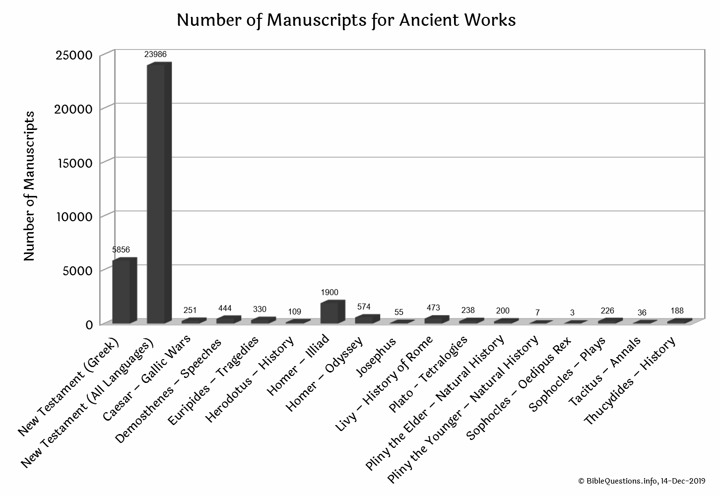
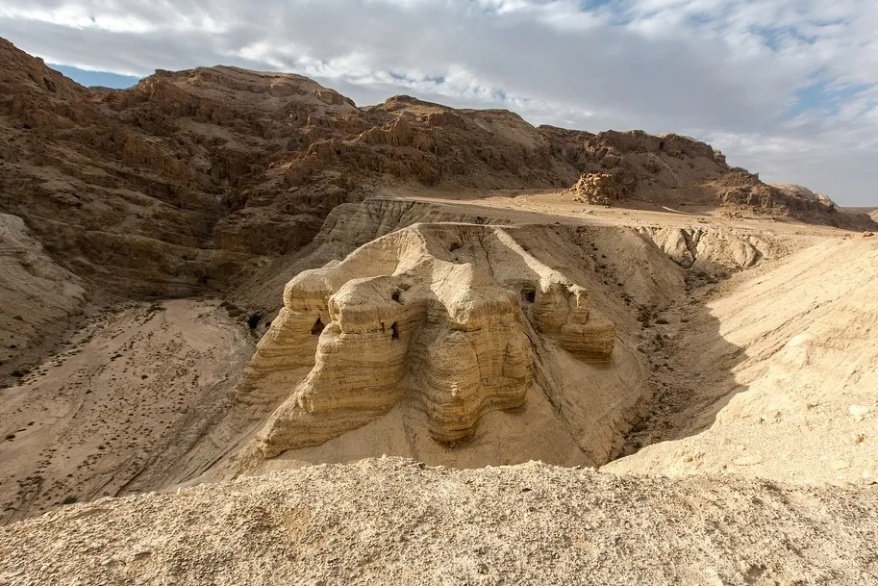
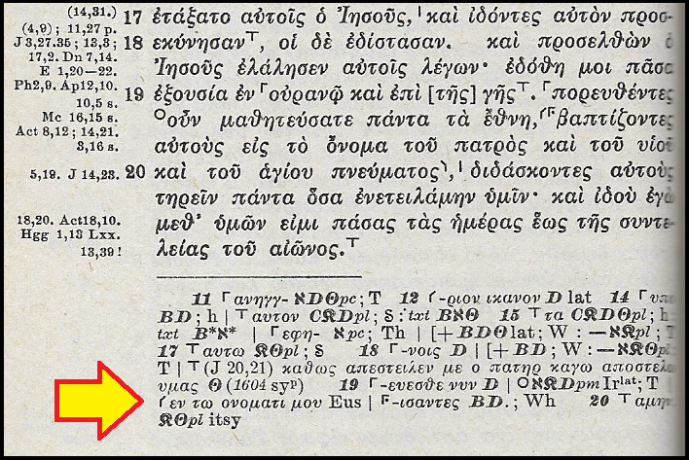
Textual transmission
The Dead Sea Scrolls discovery (1948) served to highlight the quality of our OT manuscripts
The NT manuscripts are unparalleled in terms of their number and antiquity in comparison to other ancient texts
The science of textual criticism enables very accurate reconstruction of the original text
“The interval then between the data of original. composition and the earliest extant evidence become so small to be in fact negligible, and the last foundation for any doubt that the Scripture have come down to us substantially as they were written has now been removed. Both the authenticity and the general integrity of the books of the New Testament may be regarded as finally established.”
- Sir Frederic Kenyon
Notes:
Dead Sea Scrolls found in eleven caves near Khirbet Qumran, on the northwestern shores of the Dead Sea.

Slide 4
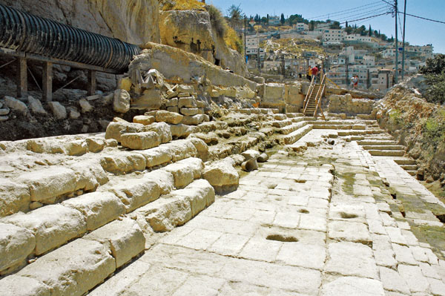
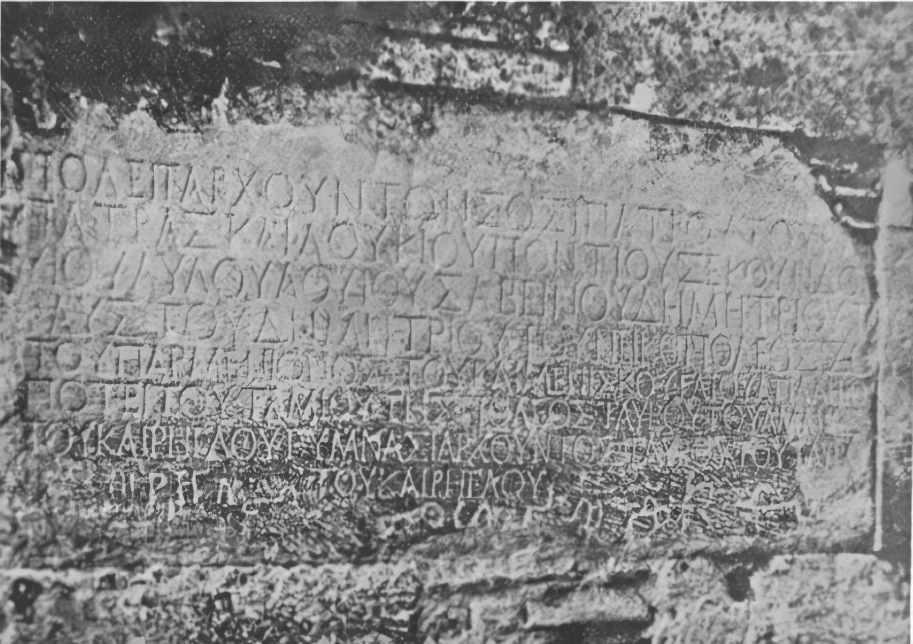
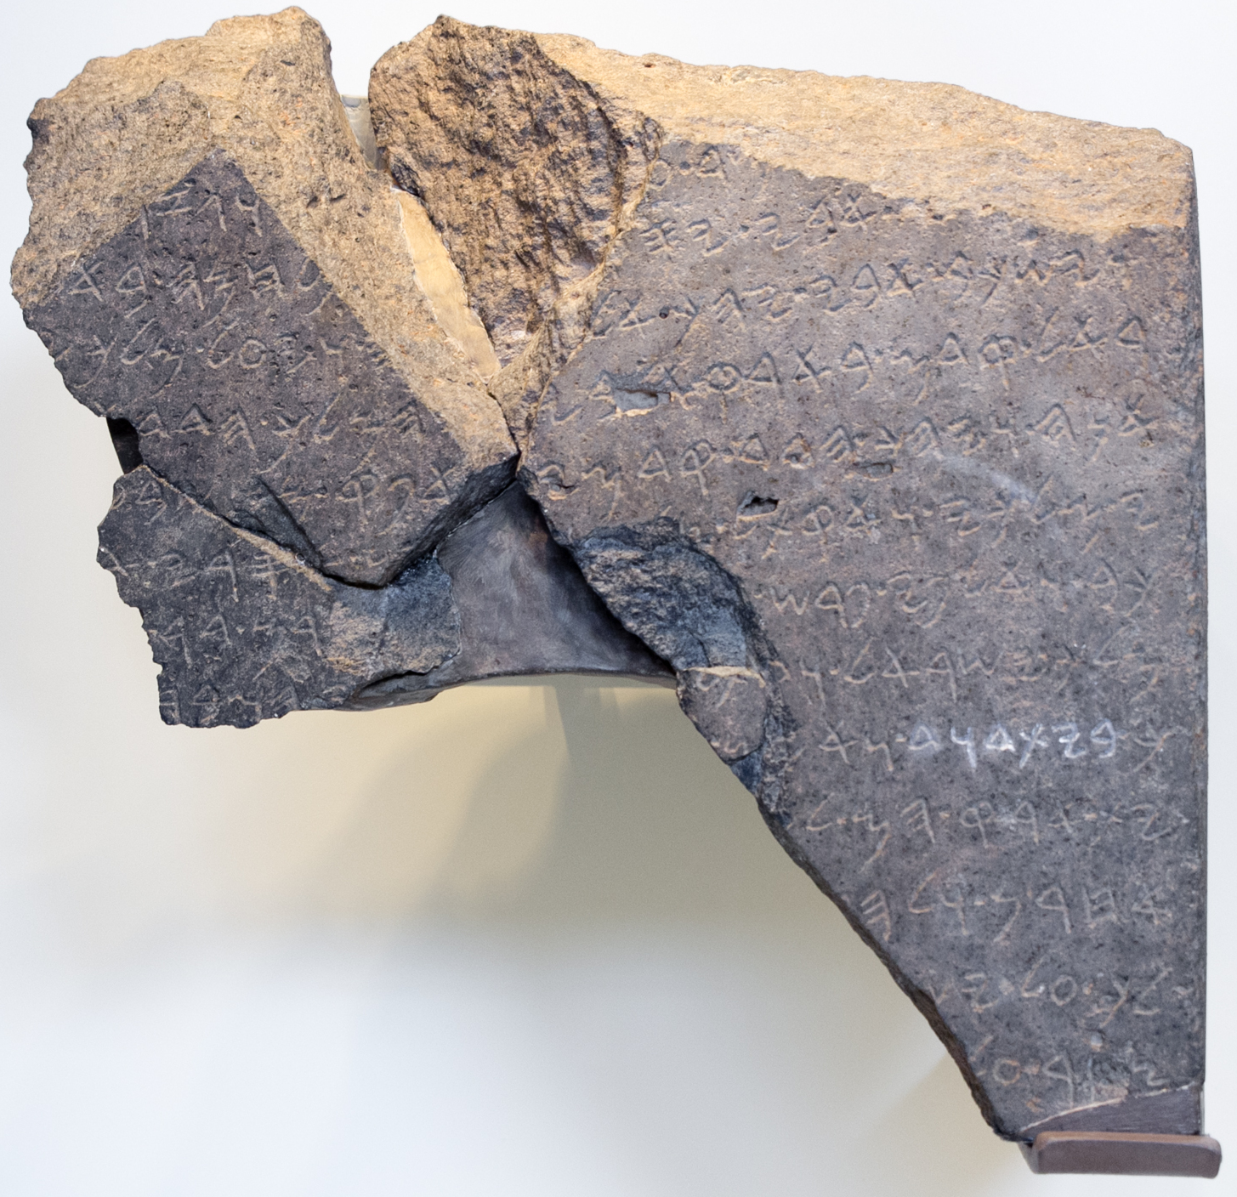
Archaeological confirmation
Discovery of the Tel Dan Stele in 1993 making clear reference to the “House of David” (9BC)
Discovery of the pool of Siloam in 2004 referred to in John 9:7 and not mentioned in any extant ancient literature
The Politarch inscription from Thessaloniki (2AD) confirms Luke’s correct use of title here: “But when they did not find them, they dragged Jason and some other believers before the city officials (πολιτάρχης)” – Acts 17:6
Notes:
A generation or two back it was fashionable, for example, for scholars to deny that king David had ever existed because there was no evidence for him outside the Bible. That is until the discovery of the Tel Dan inscription in 1993, dating from the 9C BC and made reference to the “House of David”.
There were also no known references outside of the Bible to the pool of Siloam that Jesus refers to in John 9. That is until, in 2004 during construction work to repair a large water pipe south of Jerusalem’s Temple Mount, a monumental pool with this inscription was discovered.

Slide 5
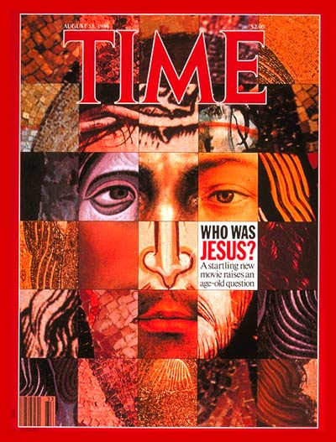
Contemporary popular culture

Slide 6
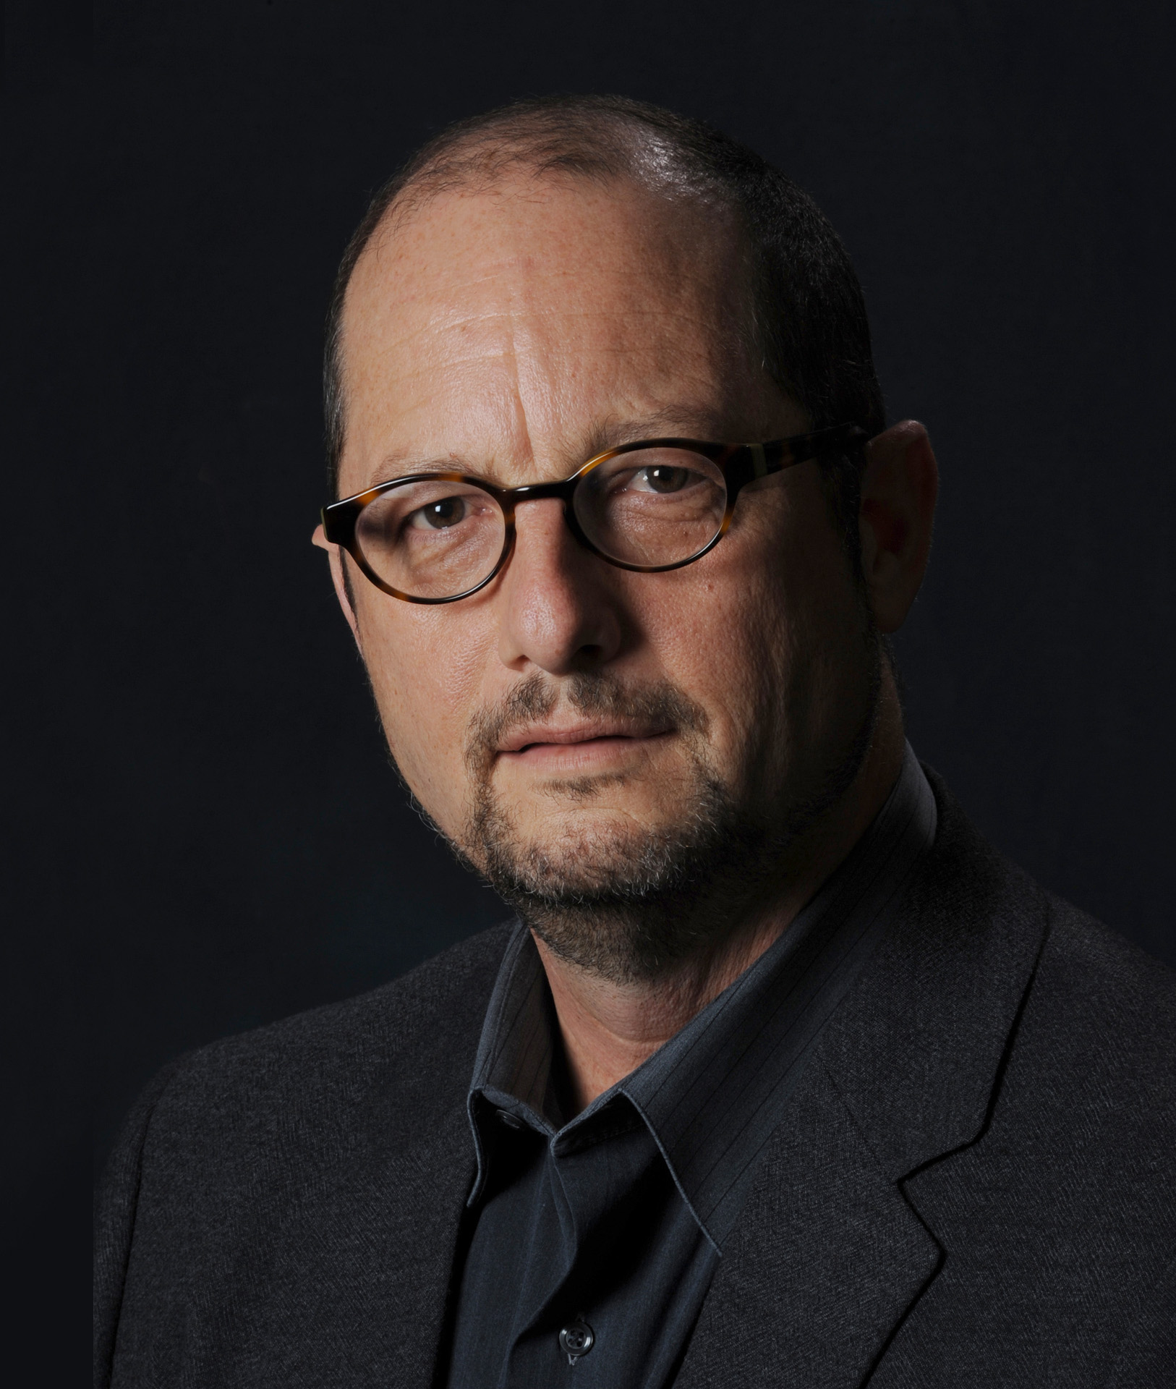
Contemporary scholarship
“Anyone who converted to become a follower of Jesus could and did tell the stories. A convert would tell his wife; if she converted, she would tell her neighbor; if she converted, she would tell her husband; if he converted, he would tell his business partner; if he converted, he would take a business trip to another city and tell his business associate; if he converted, he would tell his wife; if she converted, she would tell her neighbor . . . and on and on . . . Who, then, was telling the stories about Jesus? Just the apostles? It can’t have been just the apostles. Eventually, an author heard the stories in his church — say it was “Mark” in the city of Rome. And he wrote his account.” – Bart Ehrman How Jesus Became God (2014)

Slide 7
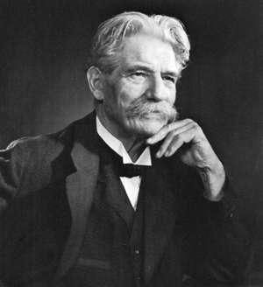
19C ‘Quests’ for the historical Jesus
D.F. Strauss - The Life of Jesus, Critically Examined (1836)
E. Renan – The Life of Jesus (1863)
A. Schweitzer – The Quest of the Historical Jesus (1906)
"The Christ that Adolf Harnack sees, looking back through nineteen centuries of Catholic darkness, is only the reflection of a liberal Protestant face, seen at the bottom of a deep well.“ – G. Tyrrell (1910)
Notes:
Strauss – an account of Jesus’ life stripped of all miraculous elements - the early church developed these stories in order to present Jesus as the Messiah of the Jewish prophecies - miracles are explained as myths developed by early Christians to support their evolving conception of Jesus
Renan – similar perspective

Slide 8
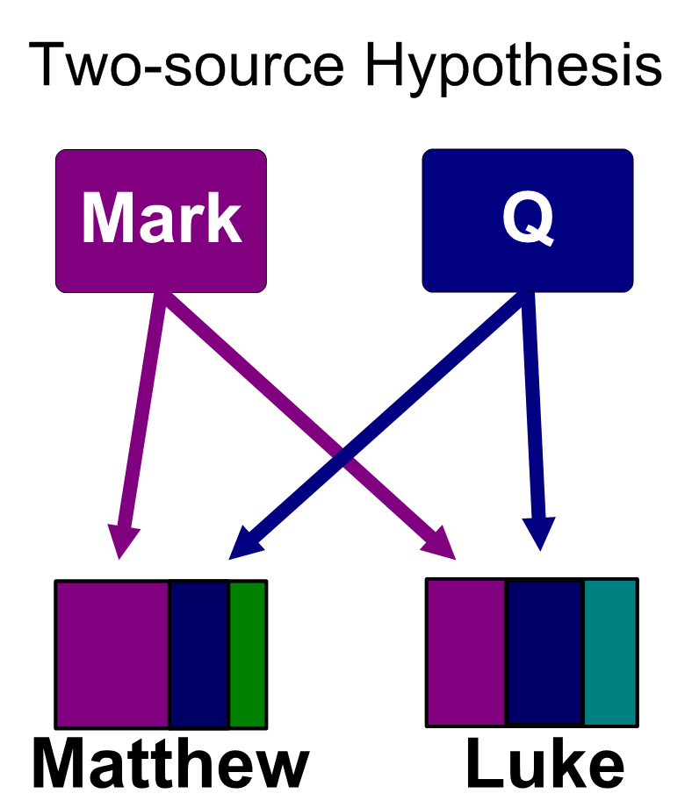
Early 20C state of gospel scholarship
Lightfoot, Westcott & Hort: establishing a 1C date for the majority of NT documents
Lachmann & Holtzmann: establish Marcan priority
Streeter – defends and refines the two-source hypothesis
Notes:
Lightfoot, Westcott & Hort established an early date for the Ignatian and Clementine epistles

Slide 9
Mid 20C form criticism
Pioneers: Schmidt, Dibelius, and Bultmann
The source material of the gospels was oral traditions about Jesus that circulated anonymously in the community and could be classified according to conventional forms: parables, aphorisms, proverbs, miracles stories, controversy stories, etc.
These short units reflected the “setting-in-life” (Sitz im Leben) of the Christian communities
The gospel writers strung these disconnected units together like “pearls on a string”
Notes:
Karl Ludwig Schmidt, Martin Dibelius, and Rudolf Bultmann

Slide 10
Late 20C approaches
Redaction criticism, literary criticism, social-scientific criticism, Jesus seminar
A third ‘quest’?
“The majority of New Testament scholars agree that the Gospels do not contain eyewitness accounts; but that they present the theologies of their communities rather than the testimony of eyewitnesses” – Wikipedia
Notes:
Characteristics of the “third quest”
How does Jesus fit with Judaism? What were Jesus’ aims? Why did Jesus die? How and why did the early church begin? What are the gospels what they are?
“The majority of New Testament scholars agree that the Gospels do not contain eyewitness accounts; but that they present the theologies of their communities rather than the testimony of eyewitnesses” – Wikipedia Historical reliability of the Gospels

Slide 11
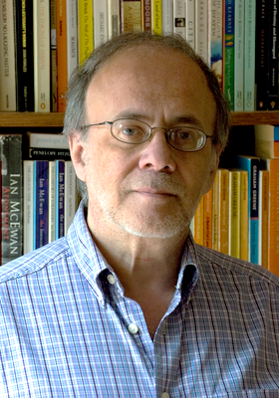
The traditional account revisited
“the traditions were originated and formulated by named eyewitnesses, in whose name they were transmitted and who remained the living and active guarantors of the traditions.” – Bauckham Jesus and the Eyewitnesses (p. 290)
“the Evangelists were in more or less direct contact with eyewitnesses, not removed from them by a long process of anonymous transmission of the traditions.” (p. 6)
Notes:
The view in the early church that the gospels were written by the apostles or by their close associates
“Testimony offers us . . . both a reputable historiographic category for reading the Gospels as history, and also a theological model for understanding the Gospels as the entirely appropriate means of access to the historical reality of Jesus.” (p. 5)
In an often-quoted comment by Vincent Taylor (1933), he wrote that “if the Form-Critics are right, the disciples must have been translated to heaven immediately after the Resurrection.”
Bauckham’s category of the gospel as testimony bridges history and theology – “But it is also a rather neglected fact that all history, like all knowledge, relies on testimony.” p. 5

Slide 12
Ancient historiography
“The ancient historians — such as Thucydides, Polybius, Josephus, and Tacitus — were convinced that true history could be written only while events were still within living memory, and they valued as their sources the oral reports of direct experience of the events by involved participants in them.” (p. 8)
“the ideal eyewitness was not the dispassionate observer but one who, as a participant, had been closest to the events and whose direct experience enabled him to understand and interpret the significance of what he had seen.” (p. 8)
“a person involved remembers better than a disinterested observer.” (p. 9)
Notes:
See the closest genre to the Gospels as Graeco-Roman biography

Slide 13
Oral tradition and oral history
“to a historian the truly distinctive characteristic of oral tradition is its transmission by word of mouth over a period longer than the contemporary generation.” (p. 31)
“Many have undertaken to draw up an account of the things that have been fulfilled among us, just as they were handed down to us by those who from the first were eyewitnesses (αὐτόπται) and servants of the word. With this in mind, since I myself have carefully investigated everything from the beginning, I too decided to write an orderly account for you, most excellent Theophilus, so that you may know the certainty of the things you have been taught.” – Luke 1:1-4
Notes:
As the emphatic “just as they were delivered to us”[ Luke 1: 2] shows, between Jesus and the earliest “literary sources” about him (including Luke, the author himself) stand only those who had been direct eye-witnesses of the activity of Jesus from the beginning. . . . Luke was an author at the end of the second generation.
With “from the beginning” and the eyewitnesses, Luke echoes the Greek historian Polybius who was widely admired as defining and exemplifying the best principles of Hellenistic historiography,

Slide 14
Names in the Gospel Traditions
“If the names are of persons well known in the Christian communities, then it also becomes likely that many of these people were themselves the eyewitnesses who first told and doubtless continued to tell the stories in which they appear and to which their names are attached.” (p. 47)
“All three Synoptic Gospels repeatedly make the women the subjects of verbs of seeing: they “saw” the events as Jesus died, they “saw” where he was laid in the tomb, they went on the first day of the week to “see” the tomb, they “saw” the stone rolled away, they “saw” the young man sitting on the right side, and the angel invited them to “see” the empty place where Jesus’ body had lain.” (p. 48)
Notes:
Bartimaeus, Simon of Cyrene and his sons, and Joseph of Arimathea, Jairus. Mary Magdalene. Jesus’ brothers: James and Joses and Judas and Simon (Mark 6)
The tendency of Matthew and Luke to omit some of the names we find in Mark would be explained if these people had become, by the time Matthew and Luke wrote, too obscure for them to wish to retain the names when they were engaged in abbreviating Mark’s narratives.
It could hardly be clearer that the Gospels are appealing to their role as eyewitnesses. The primacy of sight (often expressed in the well-known saying of Heraclitus: “Eyes are surer witnesses than ears” was a feature of the ancient Greek theory of cognition,
In this way my proposal that the Evangelists were careful to name precisely the women who were well known to them as witnesses to these crucial events in the origins of the Christian movement explains the variations among their lists of women as no other proposal has succeeded in doing.

Slide 15
Palestinian Jewish names
Most popular male names: Simon (243), Joseph (218), Eleazar (166), Judah (164), Yohanan (122), Joshua (99)
“The percentages for men in the New Testament thus correlate remarkably closely with those for the population in general.”
“We should note that the pattern of Jewish names in the Diaspora was not at all the same as in Palestine.”
How to Tell Simon from Simon: “Simon the leper” (Mark 14:3), “Simon son of Jonah” (Matt 16:17), “Simon of Cyrene” (Mark 15:21)
Notes:
I wonder if I were to ask you what are the most popular boys names and girls names in South Africa right now? I wonder how accurately you would be able to guess?
Israeli scholar Tal Ilan and was published in 2002 as Lexicon of Jewish Names in Late Antiquity: Part I: Palestine 330 BCE– 200 CE.
This correspondence is very unlikely to have resulted from addition of names to the traditions, even within Palestinian Jewish Christianity, and could not possibly have resulted from the addition of names to the traditions outside Jewish Palestine, since the pattern of Jewish name usage in the Diaspora was very different.

Slide 16
The inclusio of eyewitness testimony
Peter the first and last disciple named in Mark: “As Jesus passed along the Sea of Galilee, he saw Simon and Simon’s brother Andrew casting a net into the sea” – Mark 1:16 But go, tell his disciples and Peter, ‘He is going ahead of you into Galilee. There you will see him, just as he told you.’” – Mark 16:7
The beloved disciple the first and last named in John: “Jesus turned and saw them following” - John 1: 38 “Peter turned and saw the disciple whom Jesus loved following” – John 21:20
Notes:
Luke uses the same device to introduce some key women who were witnesses
Bauckham shows this device in other ancient biographies: Lucian’s Alexander, Porphyry’s account of Plotinus
Peter’s perspective comes through in Mark

Slide 17
Formal transmission of tradition
“For I received from the Lord what I also passed on (παρέδωκα) to you: The Lord Jesus, on the night he was betrayed, took bread” – 1 Cor 11:23
“For what I received I passed on (παρέδωκα) to you as of first importance: that Christ died for our sins according to the Scriptures, that he was buried, that he was raised on the third day according to the Scriptures, and that he appeared to Cephas, and then to the Twelve.” – 1 Cor 15:3
Clear distinctions are made between pre- and post-Easter (e.g. 1 Cor. 7, John 2:22)

Slide 18
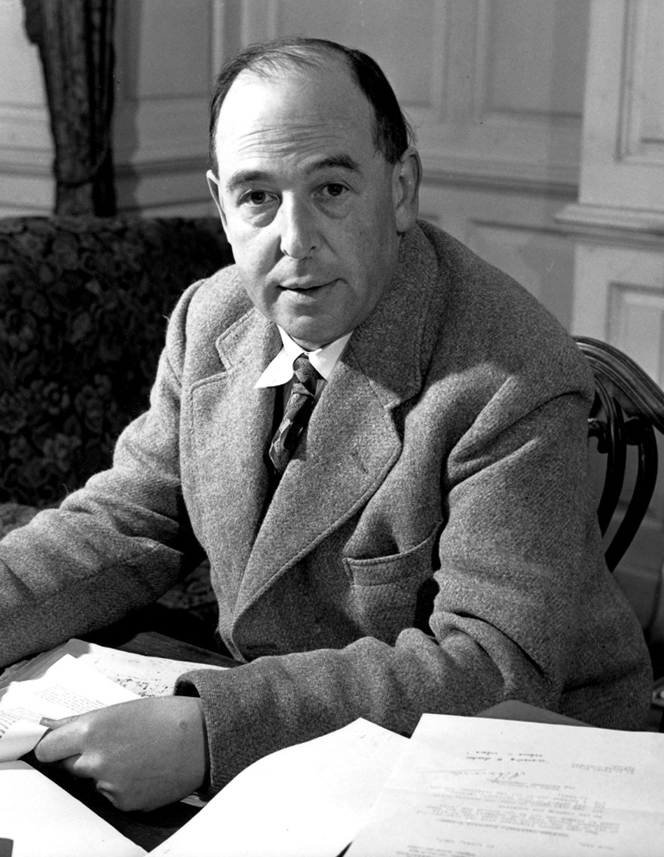
Conclusion
“If he tells me that something in a Gospel is legend or romance, I want to know how many legends and romances he has read, how well his palate is trained in detecting them by the flavour; not how many years he has spend on that Gospel. . . I have been reading poems, romances, vision-literature, legends, myths all my life. I know what they are like. I know that not one of them is like this. Of this text there are only two possible views. Either this is reportage . . . Or else, some unknown writer in the second century, without known predecessors, or successors, suddenly anticipated the whole technique of modern, novelistic, realistic narrative.”
Notes:
Lewis commenting on the skepticism of the biblical critics of his day
Fern seeds and elephants - Originally entitled 'Modern Theology and Biblical Criticism', Lewis read this essay at Westcott House, Cambridge, on 11 May 1959 – “They claim to see fern-seed and can't see an elephant ten yards way in broad daylight.”
'the personality of Jesus has no importance for the kerygma either of Paul or John... Indeed, the tradition of the earliest Church did not even unconsciously preserve a picture of his personality. Every attempt to reconstruct one remains a play of subjective imagination.’
“What evidence have we that he would recognize a personality if it were there? For it is Bultmann contra mundum. If anything whatever is common to all believers, and even to many unbelievers, it is the sense that in the Gospels they have met a personality.”

Slide 19
“All theology of the liberal type involves at some point - and often involves throughout - the claim that the real behavior and purpose and teaching of Christ came very rapidly to be misunderstood and misrepresented by his followers, and has been recovered or exhumed only by modern scholars . . . The idea that any man or writer should be opaque to those who lived in the same culture, spoke the same language, shared the same habitual imagery and unconscious assumptions, and yet be transparent to those who have none of these advantages, is in my opinion preposterous. There is an a priori improbability in it which almost no argument and no evidence could counterbalance.” – C.S. Lewis Fern Seeds and Elephants (1959)

